Slide 1
Heart Disease Prediction
By : Sahil Rahi
Kajal Sharma
Shanel Pinto
Chinju Baby
Elda Varghese

Slide 2
Prelude
The objective of the project was to apply machine learning solutions to the given processed Cleveland dataset for detecting the presence of heart disease in a person and checking the accuracy of the algorithms.

Slide 3
Process Requirements
Install the software Anaconda, Python, libraries etc.
Import the libraries in python.
Start the environment and import the dataset into it.

Slide 4
Machine Learning process
Importing the dataset
Handling the missing values
Detecting and removing outliers
Correlation between the independent and dependant attributes
Applying the Algorithms :
Decision Tree Classifier
Logistic Regression
Random Forest
Naïve Bayes

Slide 5
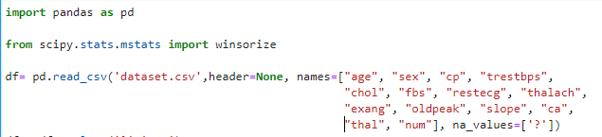
Importing the Dataset using Panda

Slide 6
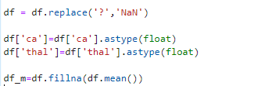
Handling the missing values

Slide 7


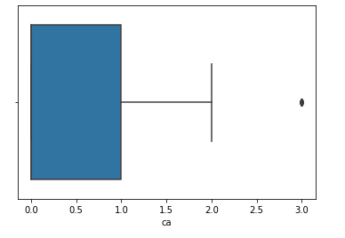
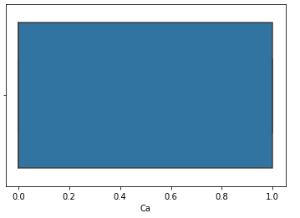
Detecting and removing outliers

